Slide 1
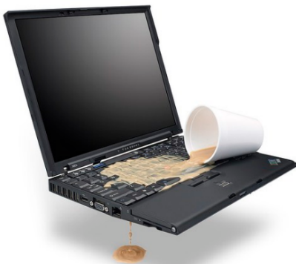
Accidental damage
Accidental damage is where you damage one of your personal items without trying to damage it on purpose. Also the ways of accidental damaging a PC are to spell drinks on in or trying to open the PC to make it better but you might damage it if you are not skilled in the ways to change the hardware of the PC.
Also the software as well can by accidentally damaged like your flies you have saved can be accidentally deleted or opening a email that has a viruses in it or letting in someone to your PC which might lead to information being stolen. Also the damage done to your PC may cost a lot of money to repair or replace.

Slide 2
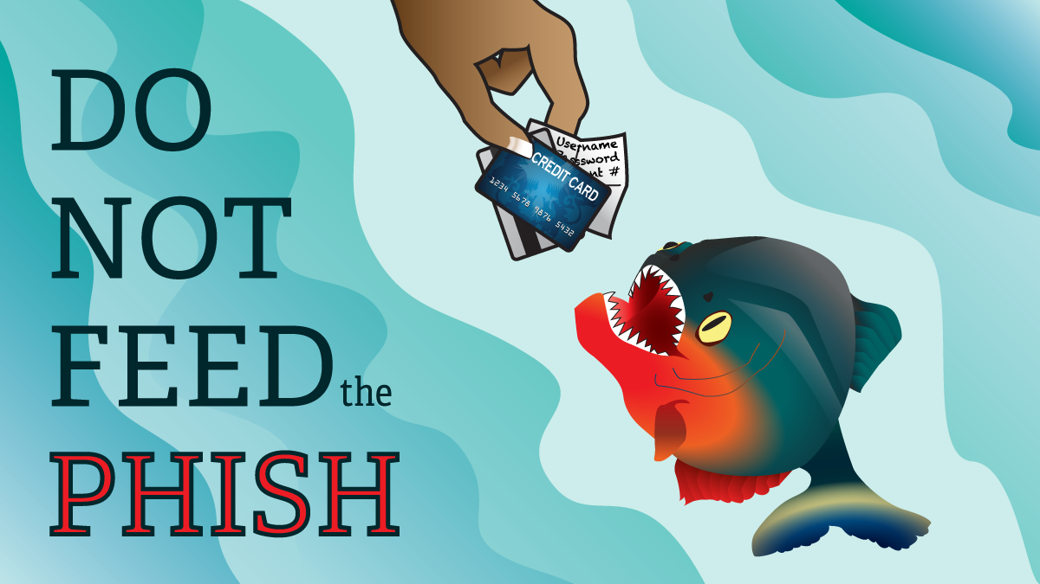
Phishing
Phishing is a way to obtain sensitive information like usernames, passwords and credit card details and the must often way to get your information is by using email which is the must common way to get in. Also the person trying to get the information will appear as a well known trustworthy web site so you will be tricked to give your information to them.
Hear are some tips to avoid a phishing email
Check for spelling mistakes
Don’t click on attachments
Beware of threatening language in the subject line
Don’t trust the display name

